Slide 1

Poverty levels and employment in Mexico state
Joshua Filiberto, Mónica cantú, bernardo gonzalez & jan hogewoning

Slide 2
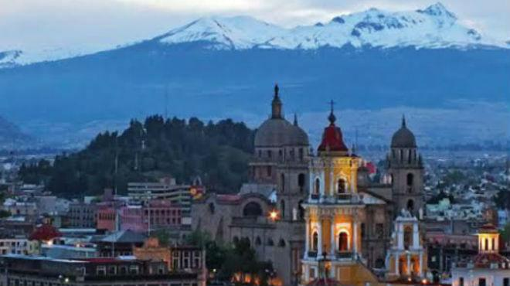
What is the mission?
CASE STUDY:
Which are better variables to understand or predict poverty levels within a Municipality in Mexico State
Are demographic – population related – variables?
Are those related to businesses industry or size?
Notes:
Source of image: https://www.unionedomex.mx/articulo/2017/11/24/educacion/mapa-del-estado-de-mexico-te-dejamos-con-y-sin-nombres

Slide 3
Hypothesis / Null-hypothesis
Hypothesis 0: Poverty levels are different according to the industry or size of existing companies.
Hypothesis 1: Poverty levels are not significantly different according to the industry or size of existing companies.

Slide 4
Data Sources
All filtered by Mexico State, gps coordinates and municipalities:
CONEVAL data on poverty level, education lag, access to healthcare, access to social security
DENUE API data on industry type, size of company
Google Maps API to build heatmaps

Slide 5
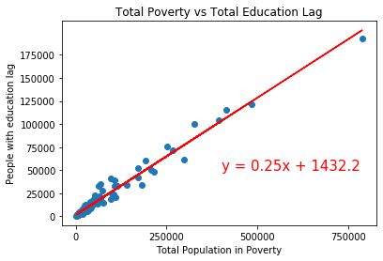
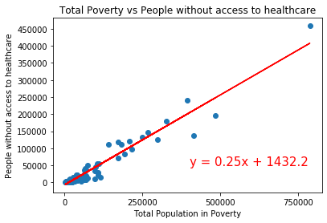
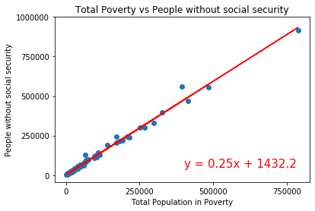
Testing poverty figures of conEval
1 – Poverty vs Education lag 3 – Poverty vs Access to social Security
2 – Poverty vs Acces to healthcare

Slide 6
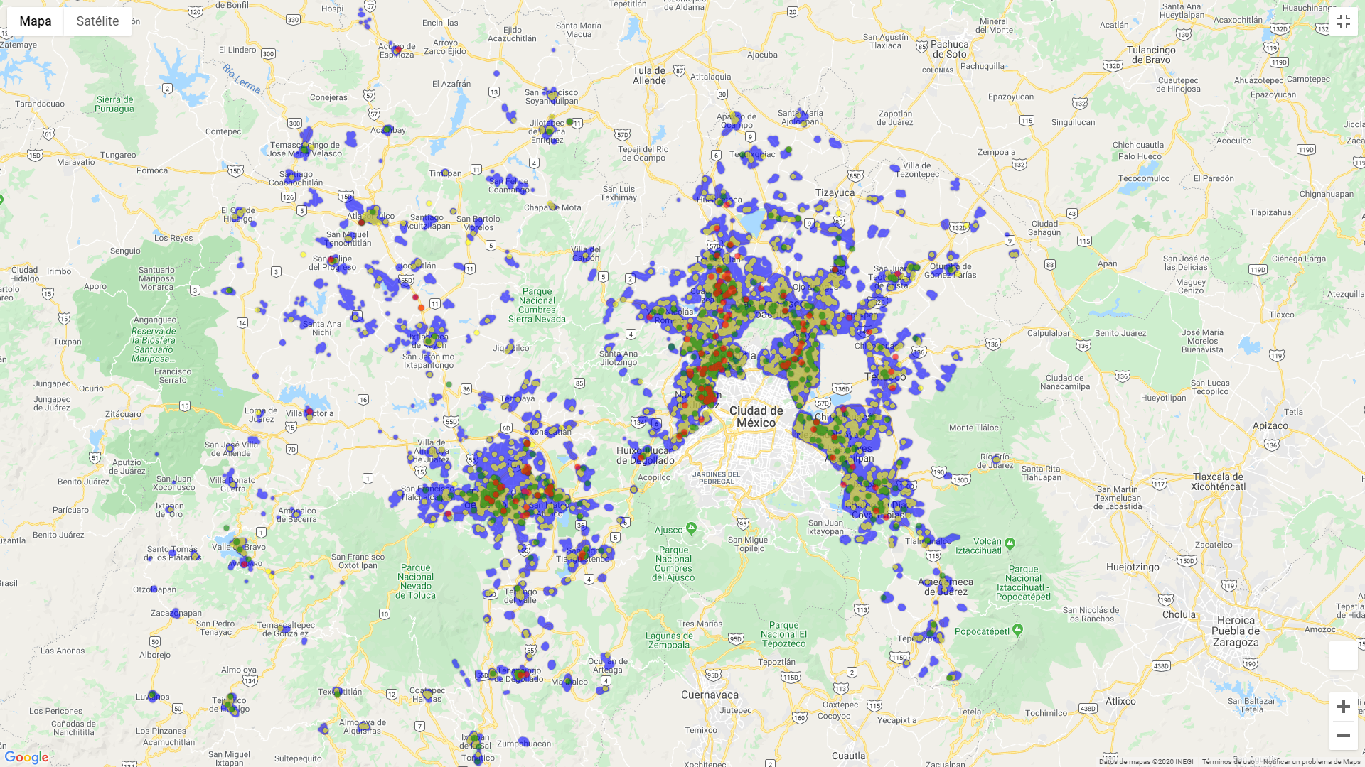
Heatmap size of companies in state of mexico

Slide 7
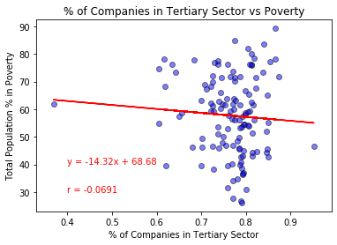
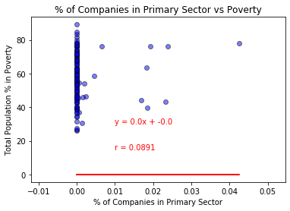
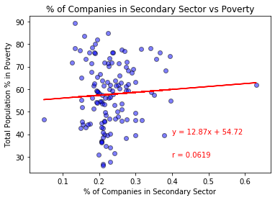
Poverty vs industry type
3.
1.
2.

Slide 8
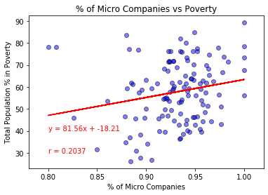
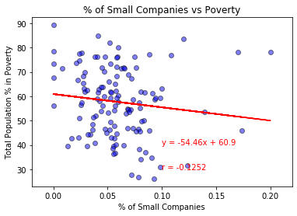
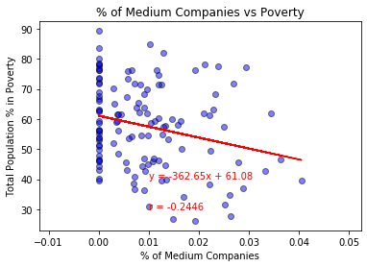
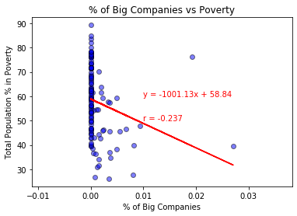
Poverty vs size of company
1.
2.
3.
4.

Slide 9
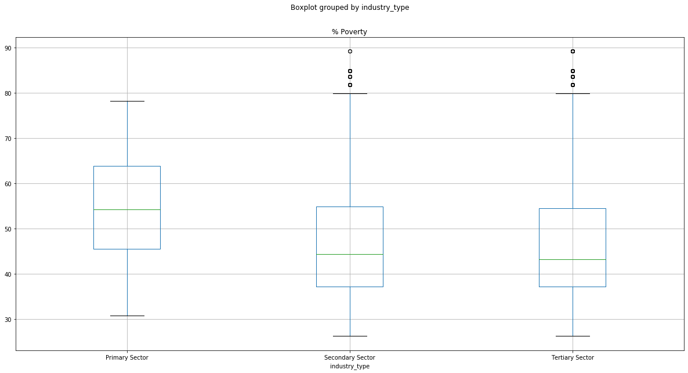

Slide 10
F-Test for poverty vs industry type

Slide 11
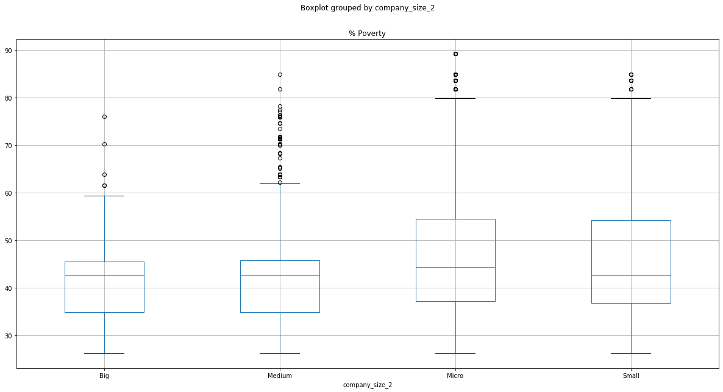

Slide 12
F-Test for poverty vs company size

Slide 13
Conclusions
Demographic variables are much better to explain poverty levels since correlations are positive and higher than company related.
However positive correlation on “Micro” businesses and negative correlation with bigger companies tells us that for less poverty there should be bigger companies
There is no statistical difference between type of industry or company size that can explain the poverty level in certain municipality
Implications

